Slide 1


Self-taught Clustering – an instance of Transfer Unsupervised Learning
†Wenyuan Dai
joint work with
‡Qiang Yang, †Gui-Rong Xue, and †Yong Yu
†Shanghai Jiao Tong University
‡Hong Kong University of Science and Technology
Notes:
Good afternoon!
Today, I’m going to talk about self-taught clustering which is an instance of transfer unsupervised learning.
I’m Wenyuan Dai.
This is a joint work with Qiang Yang, Gui-Rong Xue, and Yong Yu.

Slide 2
Outline
Motivation
Self-taught Clustering
Transfer Unsupervised Learning
Algorithm
Experiments
Conclusion
Notes:
Here is the outline of this talk.
I will first give some introduction to the motivation of our work, then define the problem of self-taught clustering, or transfer unsupervised learning.
After that, I will describe our algorithm in details.
The fourth part is about the experiments.
Finally, the conclusion will be given.

Slide 3
Outline
Motivation
Self-taught Clustering
Transfer Unsupervised Learning
Algorithm
Experiments
Conclusion
Notes:
OK, let’s move to our motivation part.

Slide 4
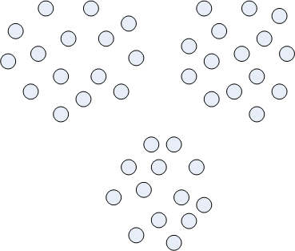
Clustering
Clustering relies on the sufficiency of data?
Notes:
Here is an example for clustering.
It’s clear that these data can be partitioned into three clusters.
However, the problem is clustering relies on large number of data. If the data are sparse, clustering may not be so easy.

Slide 5
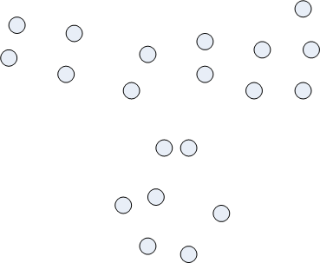
When the data are sparse, …
Notes:
Let’s see when the data are sparse.
We randomly remove some data here, to make them sparse.
Now, even human cannot cluster these data well.

Slide 6
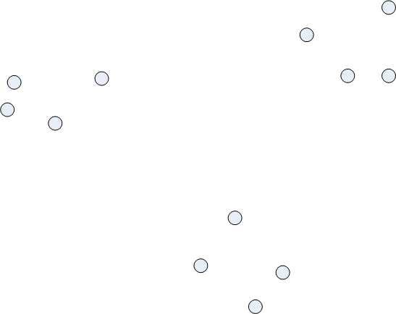
Can sparse data be clustered well?
Sometimes, it is possible.
A good data representation can make the clustering much easier.
Notes:
But, can sparse data be clustered well?
The answer is sometimes it’s possible.
For example, these data are not difficult to cluster, although they are very sparse.
The reason is these data are in a good representation. That is the data in different clusters are separated very well.
So, a good data representation can make the clustering much easier.

Slide 7
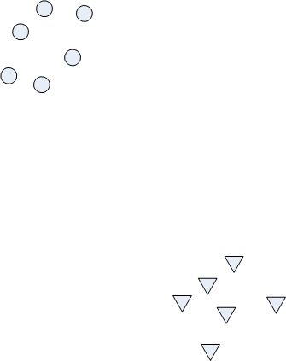

A good representation may help
transformation
Notes:
Let’s see this example.
Here, the circles are data in one cluster, while the triangles are data in another cluster.
These data are quite sparse. And, it’s not clear how to cluster these data. For example, we may cluster them in this way. Or in this way. Or in this way. … but, we don’t know which way is the best.
But, if we can seek a transformation to separate theses circles and triangles. The problem can become easier.
For example, we can cluster them like this, or like this, or like this. All these ways are OK.
In this example, the new representation is much better than the old one, because it makes the clustering task easier.
Now, the problem is how to seek a good representation for the target data.

Slide 8
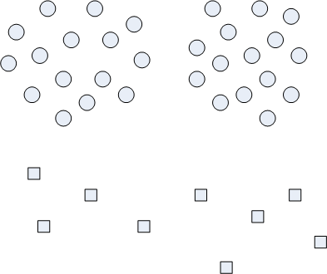
Can Transfer Learning help?
auxiliary data
target data
Notes:
In this work, we propose to use transfer learning to help the clustering task.
Here is an illustration.
In this example, the squares are target data, to be clustered. The circles are auxiliary data, to help the target clustering.
Here, the target data are quite sparse, so it’s not easy to cluster these data without any auxiliary information.
However, we have a large amount of auxiliary data, and these data can be clustered easily.

Slide 9
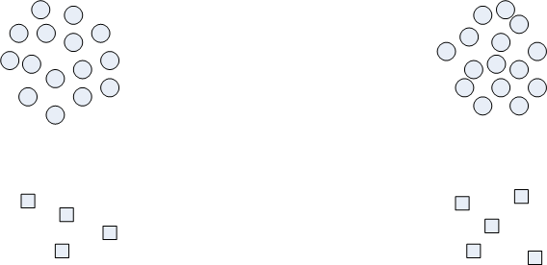
Transfer Learning can help
auxiliary data
separate the auxiliary data via transformation
target data
Notes:
We may separate the auxiliary data by transformation like this.
As a result, the target data are separated as well. Then, we can cluster these target data easily.
That’s the motivation of our work.

Slide 10
Outline
Motivation
Self-taught Clustering
Transfer Unsupervised Learning
Algorithm
Experiments
Conclusion
Notes:
We now move on to the problem definition.

Slide 11
Problem Definition
Target Data
a small collection; to be clustered
Auxiliary Data
a large amount of; be irrelevant to the target data
Objective
enhance the clustering performance on the target data by making use of the auxiliary unlabeled data
Self-taught Clustering/Transfer Unsupervised Learning
Notes:
In our problem, we have a small collection of target data. They are unlabeled, and to be clustered. Notice that, the size of target data set is assumed to be quite small, so that traditional clustering cannot cluster them well.
We also have a large amount of auxiliary data available. These data are assumed to be irrelevant to the target data.
What we want is to use these auxiliary data to help the target data clustering.
We call this problem, self-taught clustering or transfer unsupervised learning.

Slide 12
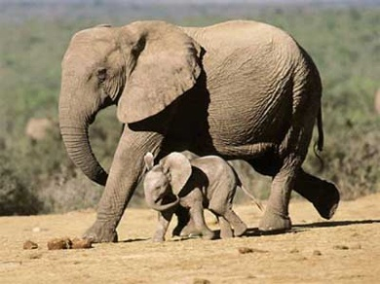
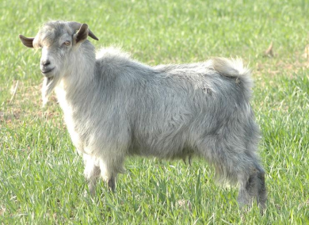
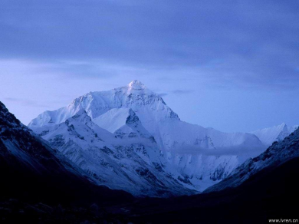
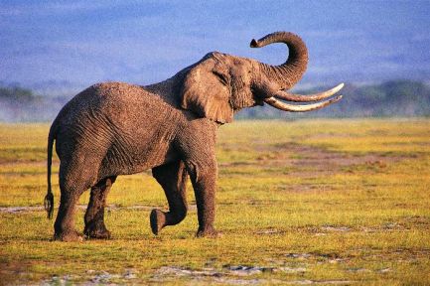
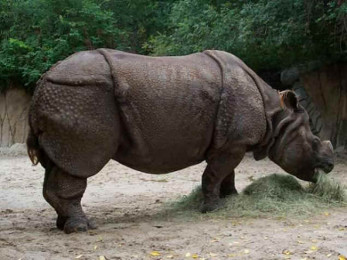
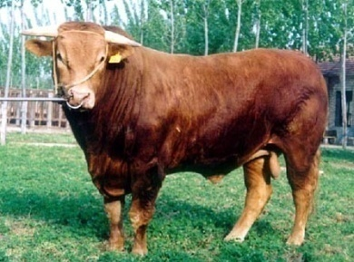
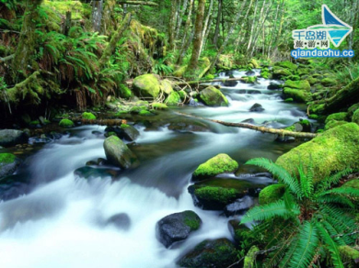
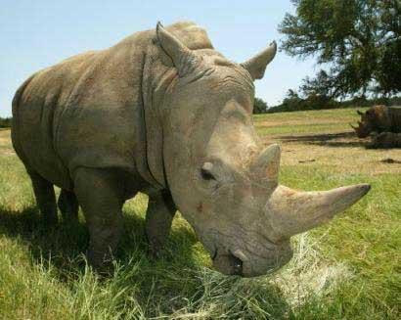
Self-taught Learning
training data
auxiliary data
test data
(Raina et al., ICML 2007)
Notes:
Here, we borrow the concept of self-taught learning, which is an ICML 2007 paper.
Here is an example for self-taught learning. The task is to classify elephants and rhinos. The pictures in blue frames are labeled data; others are unlabeled.
What self-taught learning use is a large amount of irrelevant unlabeled data, which are the auxiliary data here. Look at these data. They are sheep, bull, mountain, and water. They are all irrelevant to the target data, elephants and rhinos.
In the self-taught learning paper last year, it shows that these irrelevant unlabeled data can be used to learn high quality bases, and help the target classification, using sparse coding.

Slide 13
Self-taught Clustering
auxiliary data
target data
Notes:
And, what we want to do is a clustering version of self-taught learning.
We have a large amount of irrelevant unlabeled data. We want use these data as auxiliary data to help the clustering on the target data.
So, we call our problem self-taught clustering.

Slide 14
Transfer Learning
training data
auxiliary data
test data
(Raina et al., ICML 2006)
Notes:
We also bring the concept of transfer learning here.
In transfer learning, we have a large amount of irrelevant labeled data as auxiliary data. We want to use these auxiliary labeled data to help the target classification.
The only difference between transfer learning and self-taught learning is, the auxiliary data are labeled here.

Slide 15
Transfer Unsupervised Learning
auxiliary data
target data
Notes:
While, our problem is an unsupervised version of transfer learning.
In our problem, the auxiliary data are unlabeled, and cannot provide any supervision.
The task is clustering, or unsupervised learning, instead of classification in transfer learning.
So, we can also call our problem transfer unsupervised learning.

Slide 16
Outline
Motivation
Self-taught Clustering
Transfer Unsupervised Learning
Algorithm
Experiments
Conclusion
Notes:
Next, we will describe our algorithm.

Slide 17
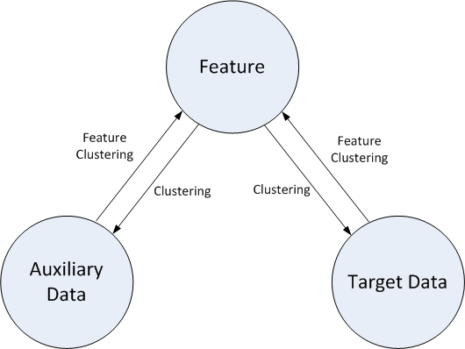
Self-taught Clustering via Co-clustering
Target Data
a small collection; to be clustered
Auxiliary Data
a large amount of; be irrelevant to the target data
co-clustering
co-clustering
Notes:
Recall our problem, we have a small collection of target data, to be clustered. We also have a large amount of auxiliary unlabeled data, which is assumed to be irrelevant to the target data in topic.
This is the scheme of our algorithm.
We have target data and auxiliary data. They are irrelevant in topic, but share a same feature space. For example, maybe they are all text, or maybe they are all images.
In our scheme, we cluster the target data and the auxiliary data simultaneously. Meanwhile, we cluster the features based on both target and auxiliary data.
So, we have two co-clusterings in the algorithm. The two co-clusterings share a common feature clustering.
The feature clustering can be considered as a data representation which is consistent between both target and auxiliary data.
So, in this algorithm, the auxiliary data take the role to help build a good data representation for the target clustering.

Slide 18

Objective Function
Notations
X = {x₁, . . . , x_{n}} and Y ={y₁, . . . , y_{m}} : X and Y correspond to the target and auxiliary data.
Z = {z₁, . . . , z_{k}} corresponds to the feature space of both target and auxiliary data.
represent the clusterings on X, Y and Z
Object function for self-taught clustering:
Information Theoretic Co-clustering (Dhillon et al., KDD 2003)
Notes:
Here is the objective function of our algorithm.
For the notation. Let X and Y be two random variables corresponding to the target and auxiliary data.
Let Z be the random variable corresponding to the features.
tilde X, tilde Y, and tilde Z denote the clusterings on X, Y, and Z.
The objective function for our self-taught clustering algorithm is defined here.
In this function, there are two information theoretic co-clusterings. Information theoretic co-clustering minimizes the information loss by co-clustering.
The two co-clusterings are optimized simultaneously.

Slide 19

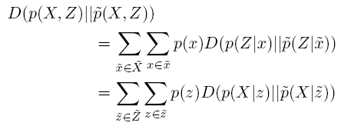
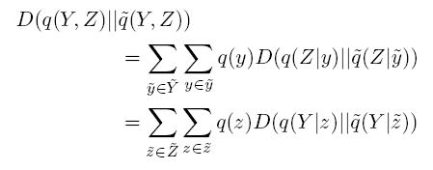
Optimization
choose the best for z to minimize
Notes:
As for optimization, the information loss can be reformulated in the form of KL-divergence. Here, D denotes KL-divergence.
Then, we reformulate the KL-divergence with regard to joint distributions to that with regard to conditional distributions, for ease of optimization.
From this formula, we can see selecting the best cluster for each z to minimize the KL-distance between p(X | z) and clustered p(X | tilde z) can reduce the value of objective function.

Slide 20



Optimization
Clustering functions (iteratively)
target data
auxiliary data
features
Notes:
So, we derive the algorithm. That is to iteratively choose the best cluster for each target instance x, auxiliary instance y and feature z. This can be proved to monotonically reduce the value of objective function, and also can be proved to converge.

Slide 21
Outline
Motivation
Self-taught Clustering
Transfer Unsupervised Learning
Algorithm
Experiments
Conclusion
Notes:
OK, the experiments.

Slide 22
Data Sets
Caltech-256 image corpus
20 categories
eyeglass, sheet-music, airplane, ostrich, fern, starfish, guitar, laptop, hibiscus, ketch, cake, harp, car-side, tire, frog, cd, comet, vcr, diamond-ring, and skyscraper
For each clustering task,
The data from the corresponding categories are used as target unlabeled data.
The data from the remaining categories are used as the auxiliary unlabeled data.
Notes:
We evaluated our algorithm on image clustering tasks.
We chose 20 categories from the Caltech-256 image corpus.
For each clustering task, we used the data from the corresponding categories as target unlabeled data, while the data from the remaining categories as the auxiliary unlabeled data.

Slide 23


Evaluation Criterion
Entropy
The entropy for a cluster is defined as
The total entropy is defined as the weighted sum of the entropy with respect to all the clusters
Notes:
The evaluation criterion is entropy.

Slide 24
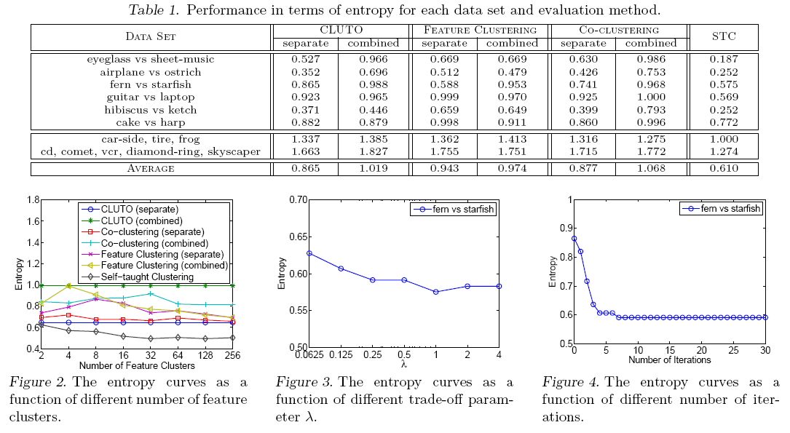
Experimental Results
Notes:
The experiments were performed on 6 binary clustering tasks, one 3-way clustering task, and one 5-way clustering task.
We compared our algorithm with three baseline methods.
CLUTO is a 1D-clustering tool.
Feature clustering means we first rebuild the data representation by feature clustering, and then apply 1D-clustering.
Co-clustering is the information theoretic co-clustering.
STC is our algorithm.
For each baseline method, we have two versions. “separate” means the clustering is applied on target data only, “combined” means the clustering is applied on the data combined with both target and auxiliary data.
From the table, we can see, our algorithm always performs better than the baseline methods.
These two figures show the parameter setting in our experiments.
Based on this figure, we set the number of feature clusters to 64.
Based on this figure, we set the trade-off parameter lambda to 1.
This figure shows the convergence property of our algorithm. You can see STC converges very well and very fast.

Slide 25
Outline
Motivation
Self-taught Clustering
Transfer Unsupervised Learning
Algorithm
Experiments
Conclusion
Notes:
Now, we conclude the whole paper.

Slide 26
Conclusion
We investigate the transfer unsupervised learning problem, called self-taught clustering.
Use irrelevant auxiliary unlabeled data to help the target clustering.
We develop a co-clustering based self-taught clustering algorithm.
Two co-clusterings are performed simultaneously between target data and features, and between auxiliary data and features.
The two co-clusterings share a common feature clustering.
The experiments show that our algorithm can improve clustering performance using irrelevant auxiliary unlabeled data.
Notes:
In this paper, we investigate the problem, self-taught clustering, which is an instance of transfer unsupervised learning.
We propose to use irrelevant auxiliary unlabeled data to enhance the target clustering.
We develop a self-taught clustering algorithm based on information theoretic co-clustering.
In our algorithm, two co-clusterings are performed simultaneously between target data and features, and between auxiliary data and features, while sharing a common feature clustering.
The experiments show encouraging performance of our self-taught clustering algorithm.

Slide 27
Question?
Notes:
Thanks you very much.
And, any questions?

